Slide 1
Getting Started with Tezos
Ali Emre Karatopuk
11 July 2023

Slide 2
Structure
Part 1: Deployment and Invocation of a Smart Contract
Part 2: Transaction of 50 tez
Part 3: Additional Research Topics
Dogami
ReasonLIGO and PascaLIGO

Slide 3
Part 3: Additional Research Topics

Slide 4
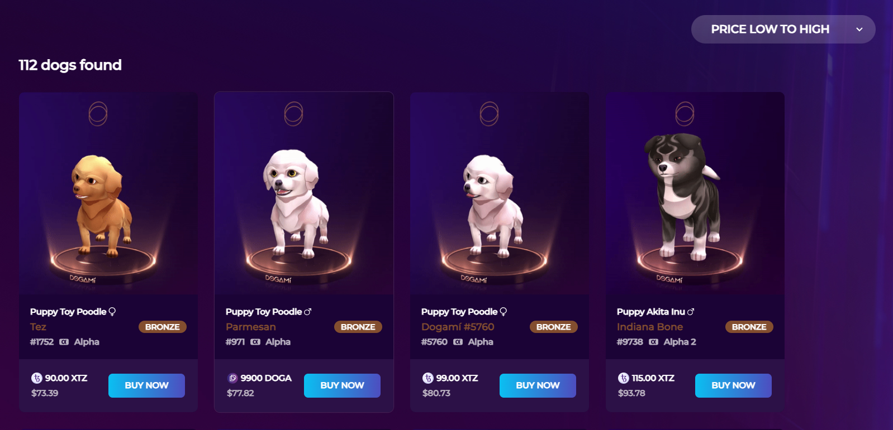
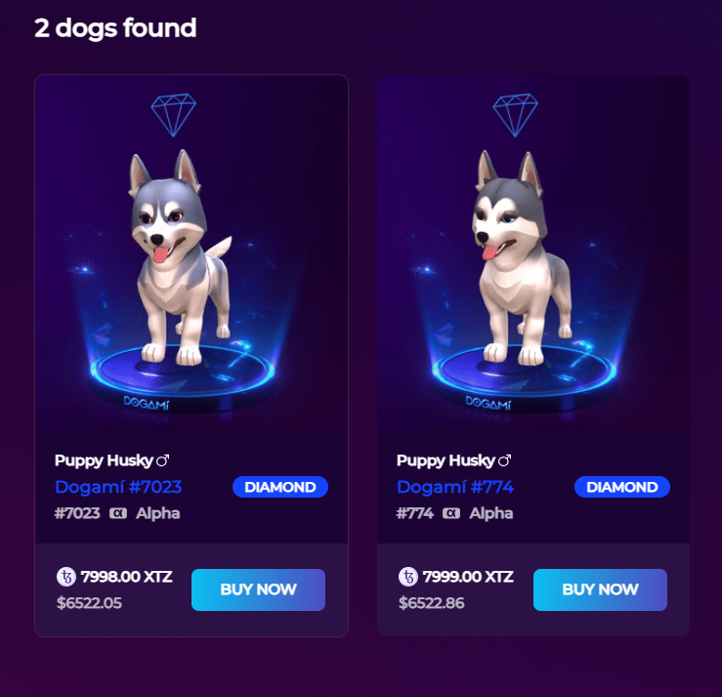


Dogami

Slide 5
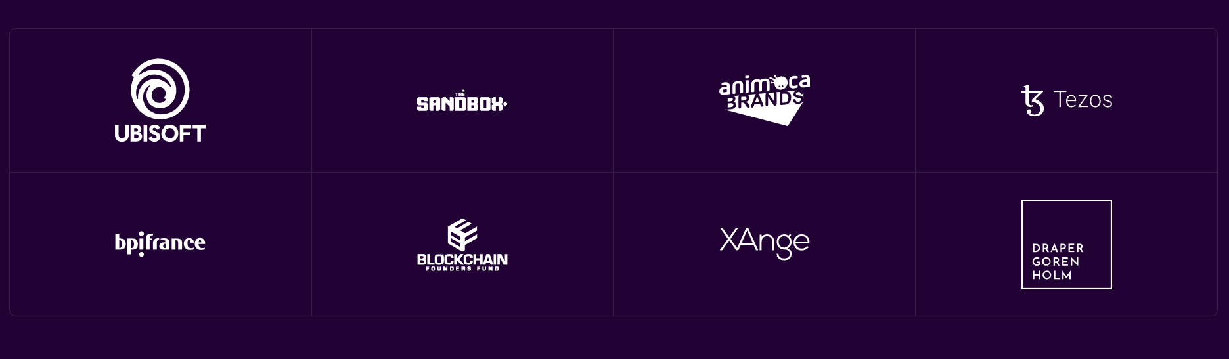
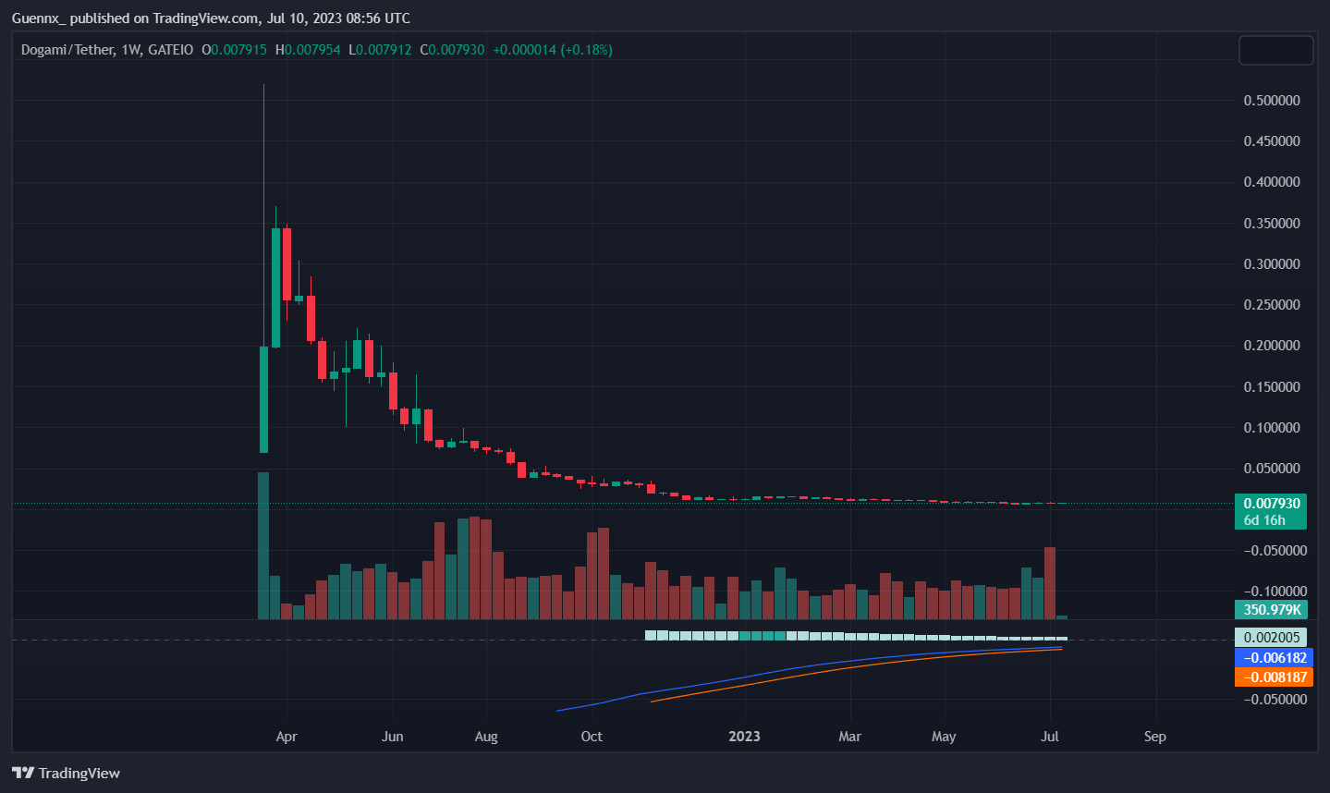
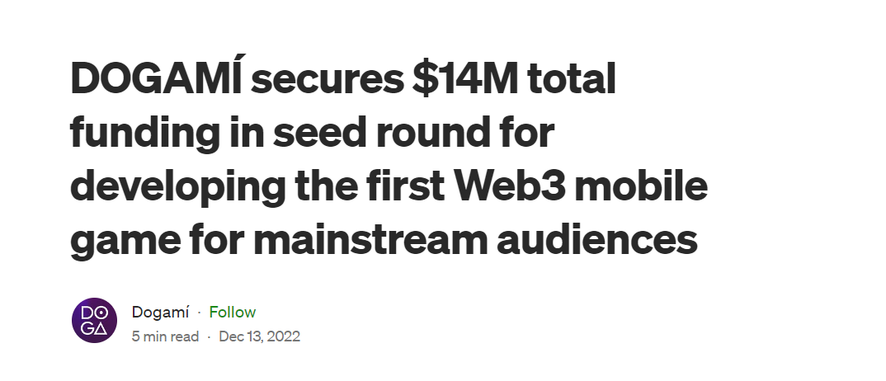
Dogami

Slide 6
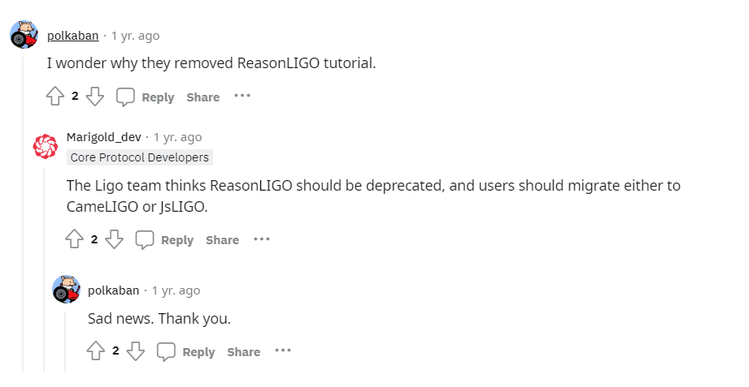
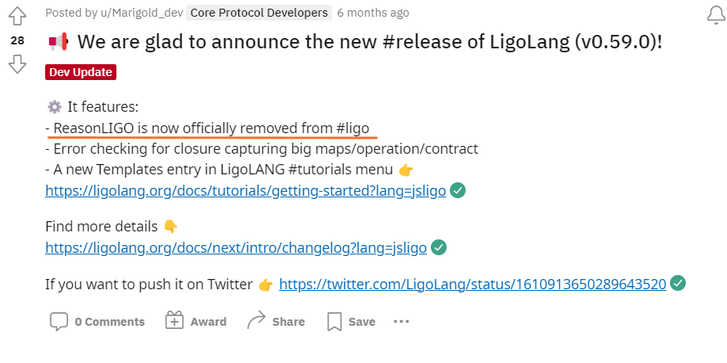
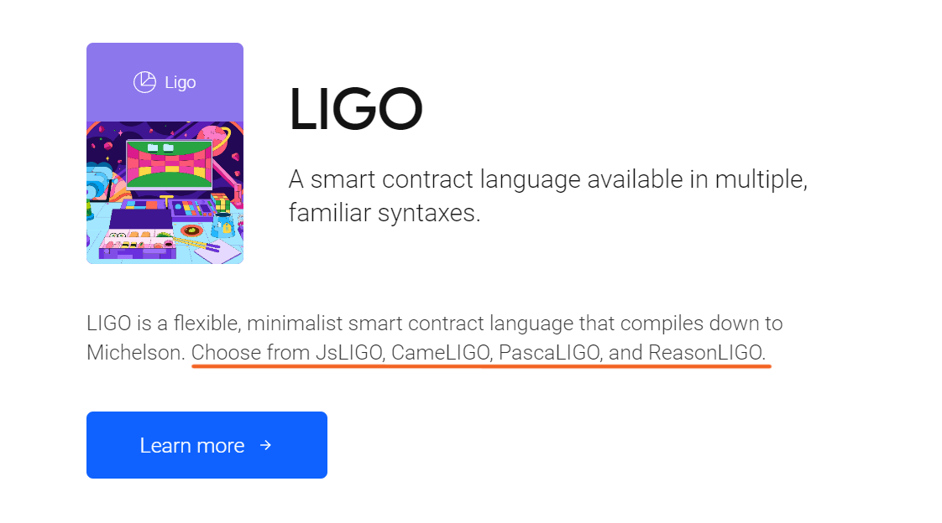
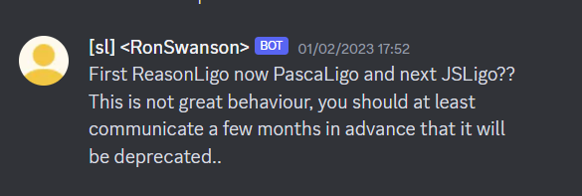
ReasonLIGO and PascaLIGO

Slide 7
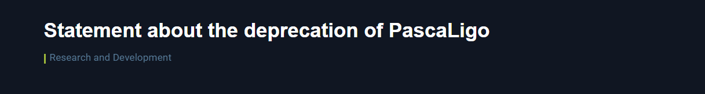
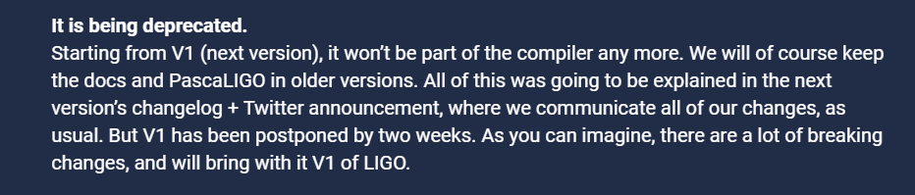
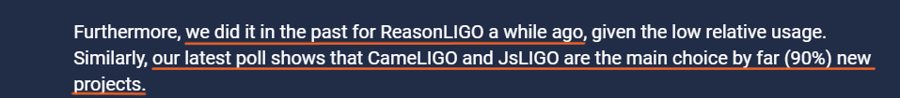
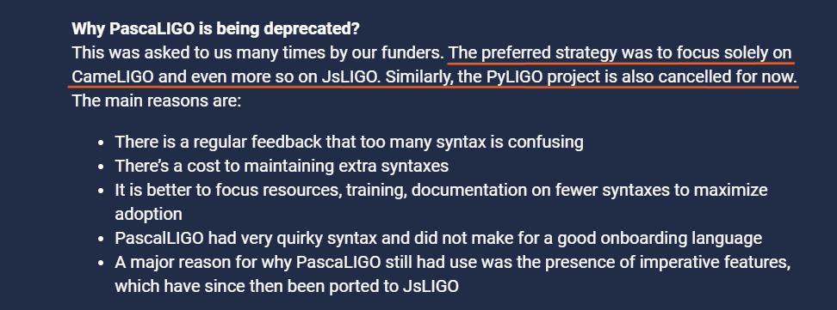
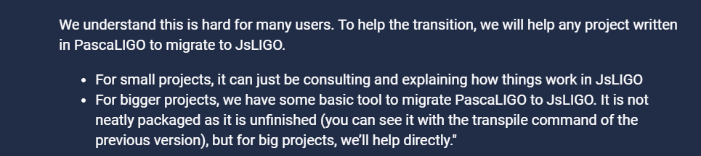
ReasonLIGO and PascaLIGO

Slide 8
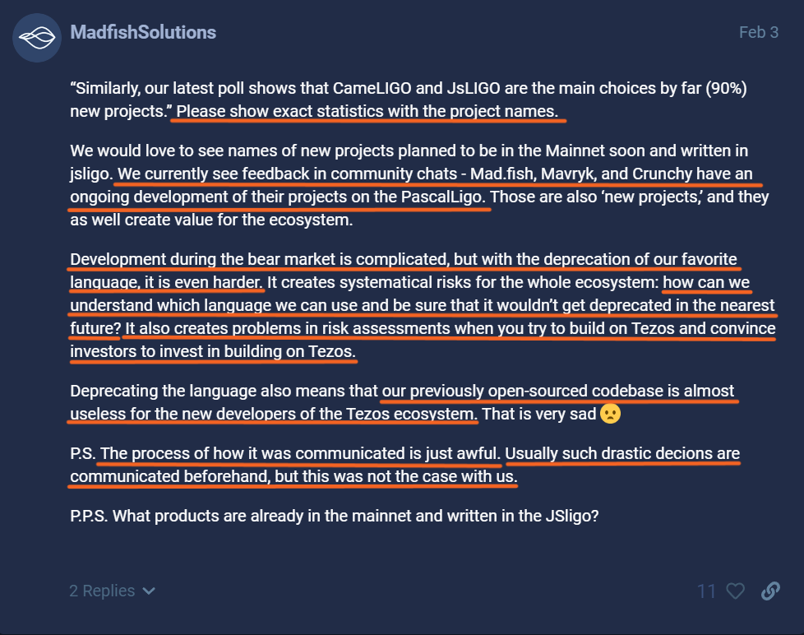
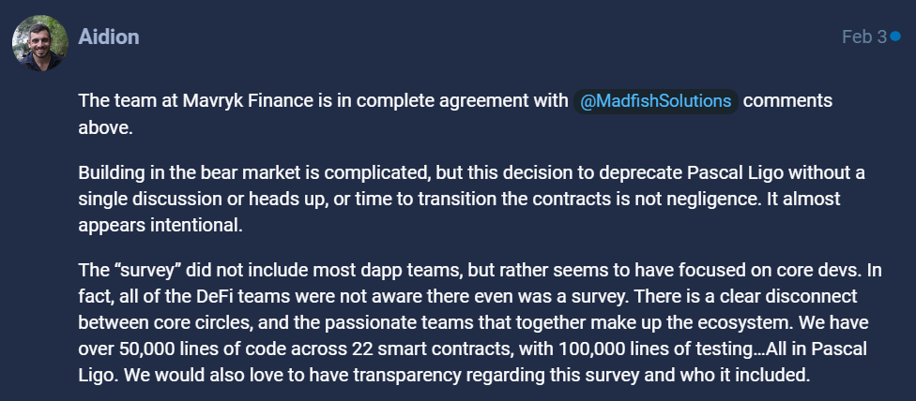
ReasonLIGO and PascaLIGO

Slide 9
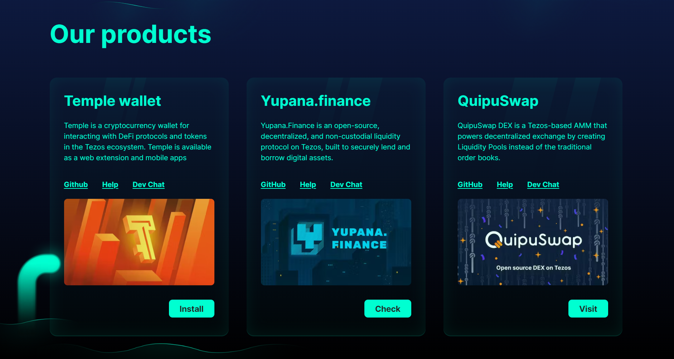
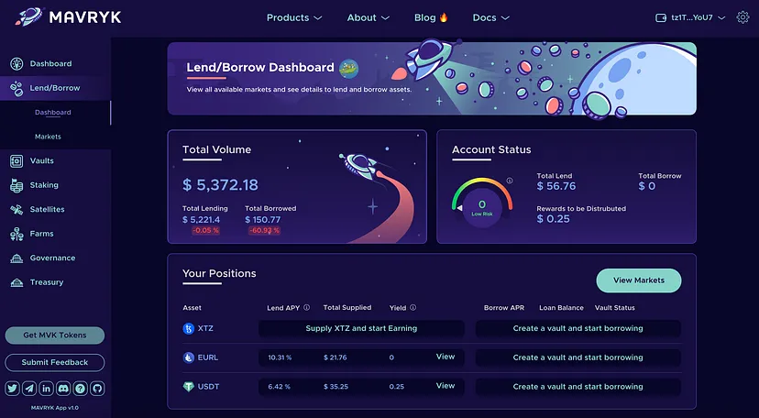

ReasonLIGO and PascaLIGO

Slide 10
References
https://dogami.com/ Retrieved 10 July 2023
https://whitepaper.dogami.com/ Retrieved 10 July 2023
https://www.tradingview.com/chart/coj3NXCf/?symbol=GATEIO%3ADOGAUSDT Retrieved 10 July 2023
https://www.reddit.com/r/tezos/comments/ut7btq/ligo/ Retrieved 10 July 2023
https://www.reddit.com/r/tezos/comments/103w055/we_are_glad_to_announce_the_new_release_of/ Retrieved 10 July 2023
https://tezos.com/developers/languages/ Retrieved 10 July 2023
https://forum.tezosagora.org/t/statement-about-the-deprecation-of-pascaligo/5085/2 Retrieved 11 July 2023
https://mad.fish/ Retrieved 11 July 2023
https://medium.com/mavryk-finance/mavryk-finance-testnet-release-1e2d42cae368 Retrieved 11 July 2023

Slide 11



Thanks

